Slide 1
Writing a Spring Web Flow
Creating Modular Page Flows
Notes:
This module will go through the process of developing a Spring Web Flow application from the ground up in a Spring MVC environment, including unit testing.

Slide 2
Topics in this Session
Defining States and Transitions
Defining the View
Actions
Subflows
Bringing It All Together

Slide 3
Topics in this Session
Defining States and Transitions
Defining the View
Actions
Subflows
Bringing It All Together

Slide 4
Contact Search Flow
Enter Search Criteria
newSearch
search
Display Search Results
Browse Result
Details
select
finish

Slide 5
XML Flow Definition Template
<?xml version=“1.0” encoding=“UTF-8”?>
<flow xmlns=http://www.springframework.org/webflow
xmlns:xsi=http://www.w3.org/2001/XMLSchema-instance”
xsi:schemaLocation=“
http://www.springframework.org/schema/webflow
http://www.springframework.org/schema/webflow/spring-webflow-1.0.xsd”>
<!-- Implement your flow here -->
</flow>

Slide 6
Creating the First Flow Definition
<flow …>
<start-state idref=“enterSearchCriteria”/>
<view-state id=“enterSearchCriteria” view=“searchCriteriaForm”>
<transition on=“search” to=“displaySearchResults” />
</view-state>
<view-state id=“displaySearchResults” view=“searchResults”>
<transition on=“select” to=“browseDetails”/>
<transition on=“newSearch” to=“enterSearchCriteria”/>
</view-state>
<view-state id=“browseDetails” view=“details”/>
<transition on=“finish” to=“displayResults”/>
</view-state>
</flow>
Enter Search Criteria
newSearch
search
Display Search Results
select
Browse Result
Details
finish

Slide 7
Inside contacts-servlet-config.xml
<bean name=“/flows.htm” class=“org.springframework.webflow.mvc.FlowController”>
<property name=“flowExector” ref=“flowExecutor”/>
</bean>
<import resource=“contacts-webflow-config.xml”/>
<bean class=“org.springframework.web.servlet.view.InternalResourceViewResolver”>
<property name=“prefix” value=“/WEB-INF/jsp/”/>
<property name=“suffix” value=“.jsp”/>
</bean>
Dispatch all Spring MVC requests for /flows.htm to Web Flow
Import the Web Flow specific system configuration
Map views selected for rendering to /WEB-INF/jsp resources (optional)

Slide 8
Inside contacts-webflow-config.xml
<flow:executor id=“flowExecutor” registry-ref=“flowDefinitionRegistry”/>
<flow:registry id=“flowDefinitionRegistry”>
<flow:location path=“/WEB-INF/flows/*-flow.xml”/>
</flow:registry>
Executes flows in registry on behalf of clients
Contains flow definitions eligible for execution

Slide 9
Topics in this Session
Defining States and Transitions
Defining the View
Actions
Subflows
Bringing It All Together

Slide 10
Going To flows.htm
DispatcherServlet
FlowController
GET /flows.htm
handleRequest(
HttpServletRequest, HttpServletResponse)
Exception:
Must provide the
_flowId or
_flowExecutionKey
parameter

Slide 11
Important Flow Executor Arguments
flowId
  needed to launch a new flow execution
flowExecutionKey
  needed to refresh and resume an existing flow execution

Slide 12
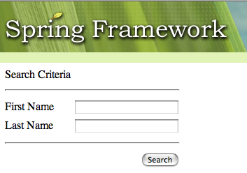
flows.htm?_flowId=search-flow
Flow pauses in view-state;
now awaiting user input

Slide 13
SearchCriteriaForm.jsp
<div id=“form”>
<form:form commandName=“searchCriteria” method=“post”>
First Name: <form:input path=“firstName”/>
Last Name: <form:input path=“lastName”/>
<div id=“buttonBar”>
<input type=“submit” value=“Search”>
<input type=“hidden” name=“_flowExecutionKey”
value=“${flowExecutionKey}”/>
<input type=“hidden” name=“_eventId” value=“search”/>
</div>
</form>
</div>
Key embedded as a hidden form field;
value will look something like
_c13bcdef456423_kbcdefca215906
Signal the ‘search’ event when the button is clicked
Notes:
The _flowExecutionKey is needed to tell SWF what instance to use.
Without the “search” _eventId it will not know what transition to use, so it will stay in the same state.
Note that the parameters, encoding of the key, etc. are all customizable. These are merely the defaults.

Slide 14
Testing the Flow (1)
public class SearchFlowExecutionTests extends AbstractXmlFlowExecutionTests {
public void testStartFlow() {
ApplicationView view = applicationView(startFlow());
assertCurrentStateEquals("enterSearchCriteria");
assertViewNameEquals("searchCriteriaForm", view);
assertModelAttributeNotNull("searchCriteria", view);
}
@Overload
protected FlowDefinitionResource getFlowDefinitionResource() {
return createFlowDefinitionResource("src/main/webapp/
WEB-INF/flows/search-flow.xml");
}
}
Notes:
This being Spring, it’s extremely easy to unit test everything about your flow.
Each test method gets a new instance of the SWF engine, instantiated with the configuration found at the given FlowDefinitionResource.
We will see later how to fire events, pass data from one state to another, and mock out services.

Slide 15
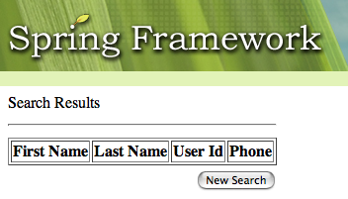
Posting Back To flows.htm (2)
DispatcherServlet
POST /flows.htm
firstName=Keith
lastName=Donald
_flowExecutionKey=
123456789
_eventId=search
Results view rendered successfully

Slide 16
Topics in this Session
Defining States and Transitions
Defining the View
Actions
Subflows
Bringing It All Together

Slide 17
Actions
Most flows need to do more than execute transitions that render views
A flow can execute arbitrary application behavior by invoking actions
Actions can be invoked from many points

Slide 18
A FormAction Bean
<beans …>
<bean id=“formAction” class=“org.springframework.webflow.action.FormAction”>
<property name=“formObjectClass” value=“contacts.SearchCriteria”/>
<property name=“validator”>
<bean class=“contacts.SearchCriteriaValidator”/>
</property>
</bean>
</beans>
public class FormAction extends AbstractAction {
public Event setupForm(RequestContext context) { …
public Event bindAndValidate(RequestContext context) { …
}
setupForm prepares the “form object”
for editing in the form
bindAndValidate binds request
parameters to the form object

Slide 19
Adding Actions
Executes before rendering view
<flow …>
<start-state idref=“enterSearchCriteria”/>
<view-state id=“enterSearchCriteria” view=“searchCriteriaForm”>
<render-actions>
<action bean=“formAction” method=“setupForm”/>
</render-actions>
<transition on=“search” to=“displaySearchResults”>
<action bean=“formAction” method=“bindAndValidate”/>
</transition>
</view-state>
…
</flow>
Executes on a search transition

Slide 20
Bean Actions
Favor centralizing all controller logic inside the flow definition where possible
  Keeps it in one place
  Less artifacts to maintain
Spring Web Flow provides several techniques for this
  A flow can bind directly to application beans to eliminate the need for custom action code

Slide 21
SearchService
public class JdbcSearchService implements SearchService {
…
@Transactional
public List<Contact> search(SearchCriteria c) {
…
}
}
The search service is just a plain Java object

Slide 22
Bean Actions XML
<flow …>
…
<view-state id=“displaySearchResults” view=“searchResults”>
<render-actions>
<bean-action bean=“searchService” method=“search”>
<method-arguments>
<argument expression=“${flowScope.searchCriteria}”/>
</method-arguments>
<method-result name=“contactList”/>
</bean-action>
</render-actions>
</view-state>
</flow>
Invoke the ‘search’ method
on ‘searchService’ by passing
it the ‘searchCriteria’ object
in flow scope and exposing the result
with name ‘contactList’
Notes:
Render actions are actions that get invoked before the view is rendered, making it the perfect place to get information to be rendered.
Also mention that it is possible to call actions via a more concise expression syntax.

Slide 23
Testing the Flow (2)
public void testCriteriaSubmitSuccess() {
startFlow();
MockParameterMap parameters = new MockParameterMap();
parameters.put("firstName", "Keith");
parameters.put("lastName", "Donald");
ApplicationView view = applicationView(signalEvent("search", parameters));
assertCurrentStateEquals("displaySearchResults");
assertViewNameEquals("searchResults", view);
assertModelAttributeCollectionSize(1, "contactList", view);
}
@Overload
protected void registerMockServices(MockFlowServiceLocator serviceRegistry) {
serviceRegistry.registerBean("searchService", new StubSearchService());
}
Notes:
Notice how events and data are signaled, as well as how to tell it how to use a stub for a service.

Slide 24
SearchResults.jsp
<div id=“content”>
Search Results
<table>
<c:forEach var=“contact” items=“${contactList}”>
<tr>
<td>${contact.firstName}</td>
<td>${contact.lastName}</td>
<td>${contact.userId}</td>
<td>${contact.phone}</td>
</tr>
</c:forEach>
</table>
</div>
Method result exposed by flow
public class Contact {
private String firstName;
private String lastName;
private String userId;
private String phone;
}

Slide 25
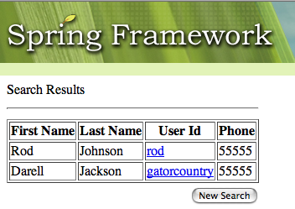
Posting Back To flows.htm (3)
DispatcherServlet
POST /flows.htm
firstName=Rod
lastName=Johnson
_flowExecutionKey=
123456789
_eventId=search
Results view rendered with data

Slide 26
Topics in this Session
Defining States and Transitions
Defining the View
Actions
Subflows
Bringing It All Together

Slide 27
Browse Details Sub Process
Browsing results details is a sub process
  Consists of several steps in its own right
The flow definition concept allows you to model any process as a self-contained module
You can create a “details” flow and call it as a sub flow from your search flow
  A flow is a black box
  You can start it with input and respond to its output when it finishes, but you cannot see inside it

Slide 28
Browsing Details
<flow …>
…
<view-state id=“displaySearchResults” view=“searchResults”>
<render-actions>
<bean-action bean=“searchService” method=“search” …/>
</render-actions>
<transition on=“select” to=“browseDetails”/>
</view-state>
<subflow-state id=“browseDetails” flow=“details-flow”>
<attribute-mapper>
<input-mapper>
<mapping source=“requestParameters.id” target=“id” from=“string” to=“long”/>
</input-mapper>
</attribute-mapper>
</subflow-state>
</flow>
Launch the details
flow as a sub flow
Pass the ‘id’ request parameter
as input to the sub flow, converting
the data type

Slide 29
The Details Flow
<flow …>
<input-mapper>
<input-attribute name=“id”/>
</input-mapper>
<start-state idref=“displayContactDetails”/>
<view-state id=“displayContactDetails” view=“details”/>
<render-actions>
<bean-action bean=“searchService” method=“getContact”>
<method-arguments>
<argument expression=“flowScope.id”/>
</method-arguments>
<method-result name=“contact”/>
</bean-action>
</render-actions>
<transition on=“back” to=“finish”/>
</view-state>
<end-state id=“finish”/>
</flow>
Map input into
flow scope
Load contact details
before rendering
End flow on “back” with a
“finish” outcome

Slide 30
Topics in this Session
Defining States and Transitions
Defining the View
Actions
Subflows
Bringing It All Together

Slide 31
Putting It All Together - Search Flow
<flow …>
<start-state idref=“enterSearchCriteria”/>
<view-state id=“enterSearchCriteria” view=“searchCriteriaForm”>
<render-actions>
<action bean=“formAction” method=“setupForm”/>
</render-actions>
<transition on=“search” to=“displaySearchResults”>
<action bean=“formAction” method=“bindAndValidate”/>
</transition>
</view-state>
<view-state id=“displaySearchResults” view=“searchResults”>
<render-actions>
<bean-action bean=“searchService” method=“search” …/>
</render-actions>
<transition on=“select” to=“browseDetails”/>
</view-state>
…

Slide 32
Putting It All Together - Search Flow (2)
…
<subflow-state id=“browseDetails” flow=“details-flow”>
<attribute-mapper>
<input-mapper>
<mapping source=“requestParameters.id” target=“id” from=“string” to=“long”/>
</input-mapper>
</attribute-mapper>
<transition on=“finish” to=“displaySearchResults”/>
</subflow-state>
</flow>

Slide 33
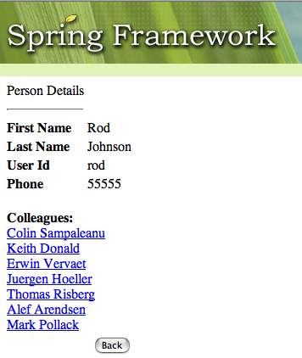
Completed Contacts Application
newSearch
search
select
finish

Slide 34
LAB
Web Flow Lab

